Slide 1
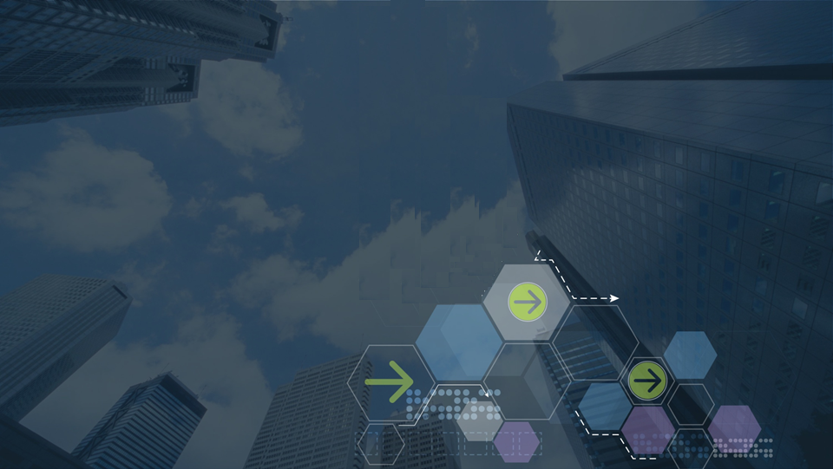

IBM Blockchain Fabric Composer Early Program
Understanding Getting Started
V1.0, 2nd Feb 2017
© 2016, 2017 IBM Corporation

Slide 2






Contents (edit here and adjacent)
is Blockchain?
is it relevant for our business?
can IBM help us apply Blockchain?
© 2016, 2017 IBM Corporation
Page
2

Slide 3



Understanding Getting Started
Aim is to understand the structure of how the Getting Started Application has been put together and what is doing
G.S is a business network involved in buying and selling property
Simplified to showing ‘people’ and ‘land registry’ and a ‘land title’
It has all the 3 layers – Apps , Composer, Fabric
Business Application
Fabric Composer
Hyperledger Fabric

Slide 4
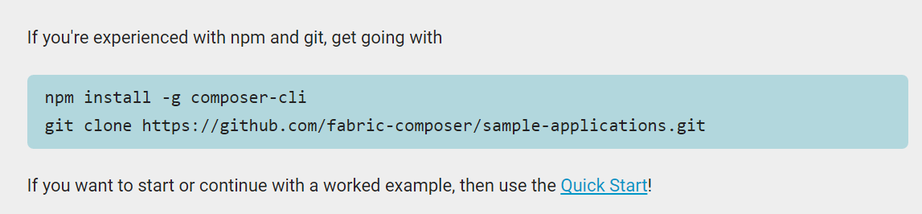
Home page

Slide 5
Show video of hf install

Slide 6
Show video of network create and deploy
install

Slide 7
Show video of network create and deploy
install

Slide 10


Contents (edit here and adjacent)
is Blockchain?
is it relevant for our business?
can IBM help us apply Blockchain?
© 2016, 2017 IBM Corporation
Page
10

Slide 11
Slide Heading here
Notes:
Other benefits include :
Improve discoverability
When everyone on an exchange can view the same ledger, it is easy to broadcast an intention (or offer) by appending it. For example, in a trading network, all asks and bids would be visible to every network participant.
Automate trusted processes
Unlike a centralized system where only the network operator can create a generalized solution that fits every user’s needs, Blockchain networks allow each participant to create customized solutions using their own proprietary business logic while running on the same common ledger.
Ensure trusted record-keeping
By design, no one party can modify, delete, or even append any record to the ledger without the consensus from others on the network, making the system useful for ensuring the immutability of contracts and other legal documents.

Slide 12

Contents (edit here and adjacent)
is Blockchain?
is it relevant for our business?
can IBM help us apply Blockchain?
© 2016, 2017 IBM Corporation
Page
12

Slide 13
Structure of getting started
@ a high level have these main building blocks in the git repo or pulled in by the git repo
Focus on the scripts…
Business Network Definition
Node.js application
scripts
Docker images for Hyperledger

Slide 14
Scripts
Best controlled via npm run
Bash / node.js apps / ComposerCLI
scripts

Slide 15
Flow of the scripts….
$ npm install
$ npm test
Pull down HLF Docker images
Add some tests assets
Start HLF
List the asset registry
Create & deploy Network Archive
Submit a transaction
npm install dependancies
List the asset registry

Slide 16
Flow of the scripts….
$ npm install
Pull down HLF Docker images
bash shell scripts Contained in the scripts subdirectory of the application
Start HLF
Create & deploy Network Archive
fabric-composer command line
npm install dependancies
Standard npm process to pull in the fabric-composer client api modules

Slide 17
Flow of the scripts….
$ npm test
Add some tests assets
Node.js appliations All contained in a single javascript class using command line options to select the require ability.
List the asset registry
Submit a transaction
List the asset registry

Slide 18
Structure of getting started
@ network definition
App is the fabric composer npms modules
Cli
Landregistry.js
M
Model
Netowrk functions
model
cli
Landregistry.js
Network fns
fabric-composer
scripts
Hyperledger Fabric

Slide 19
Bash scripts
Used to start, stop and teardown HLF
Download as docker images
Also teardown cleans the Composer Connection Profiles & Credentials (more later)

Slide 20
Composer CLI
Command line tools to work with Business networks
For all phases of their ‘lifecycle’ from creation to deployment, removal and management
All implemented as node.js applications that call the Composer Client and Admin API.
Could be coded as part of end application if wished.

Slide 21
Node.js applications
Part of getting started that represents the end application
They are build using
Standard JS command line processor
Single class implementing the functions
Bootstrap some assets
List assets
Submit transactions

Slide 23


Summary
Topic Name …

Slide 24
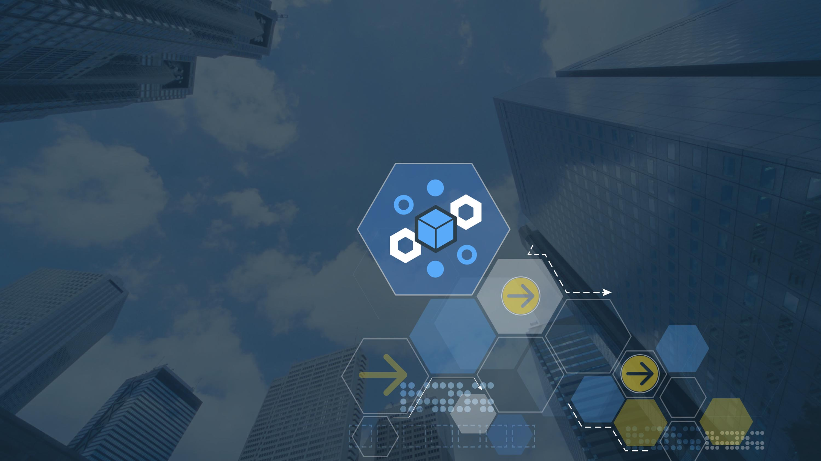
Thank you!
© 2016, 2017 IBM Corporation

